Slide 1
Huron Computer Science Club (Video Game development branch)
By Board

Slide 2
Video Game Development
Lead by Jack and Tai

Slide 3
Video Game Development
Video Game Development is the main branch of the club, inherited from the former videogame development Club.

Slide 4
Tools
Godot
Blender
Krita
Musescore
etc

Slide 5
Learning curriculum
Godot
Overview of the interface
Nodes and Scenes
Instances and objects
Scripting
PROJECT!

Slide 6
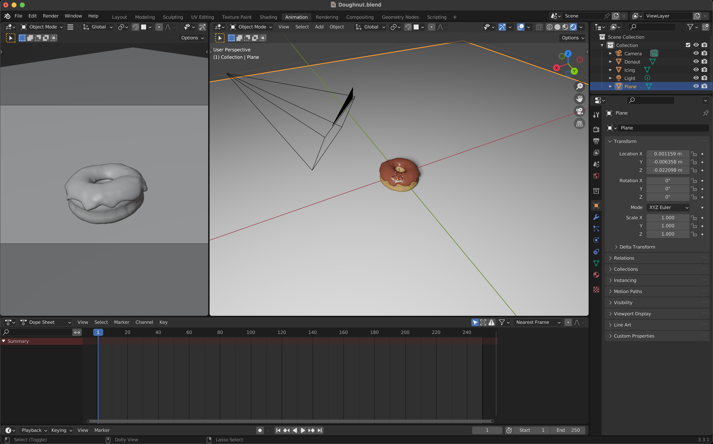
Learning curriculum
Blender
Donut tutorial

Slide 7
Tutoring
Lead By Tom, Jack

Slide 8
E-sports
Lead by Tim Wang, Eric Li

Slide 9
Competition

